Slide 1
CS2160 Arithmetic for Computers

Slide 2
Arithmetic for Computers
§3.1 Introduction
Operations on integers
Addition and subtraction
Multiplication and division
Dealing with overflow
Floating-point real numbers
Representation and operations
178

Slide 3
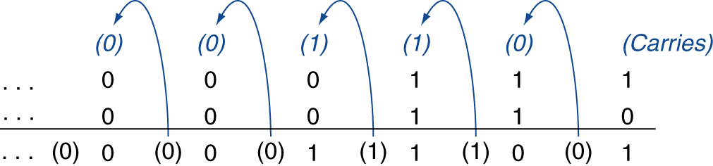
Integer Addition
Example: 7 + 6
§3.2 Addition and Subtraction
Overflow if result out of range
Adding +ve and –ve operands, no overflow
Adding two +ve operands
Overflow if result sign is 1
Adding two –ve operands
Overflow if result sign is 0
179

Slide 4
Integer Subtraction
Add negation of second operand
Example: 7 – 6 = 7 + (–6)
+7: 0000 0000 … 0000 0111 –6: 1111 1111 … 1111 1010 +1: 0000 0000 … 0000 0001
Overflow if result out of range
Subtracting two + or two negative operands, no overflow
Subtracting + from negative operand
Overflow if result sign is 0
Subtracting negative from positive operand
Overflow if result sign is 1
179

Slide 5
Dealing with Overflow
Some languages (e.g., C) ignore overflow
Use MIPS addu, addui, subu instructions
Other languages (e.g., Ada, Fortran) require raising an exception
Use MIPS add, addi, sub instructions
On overflow, invoke exception handler
Save PC in exception program counter (EPC) register
Jump to predefined handler address
mfc0 (move from coprocessor reg) instruction can retrieve EPC value, to return after corrective action
180

Slide 6
Overflow Indicators
180

Slide 7
Handling Overflow
Causes an interrupt or an exception to occur
There are HW and SW interrupts
MIPS uses a software interrupt for overflow
So it has to actually check for it
OS is called to take care of the situation
Finds out what caused the problem
Decides if something needs to be fixed or ignored
Does the fix if appropriate
Ignores if appropriate
Terminates program if necessary.
180

Slide 8
Interrupt Handling in General
MIPS processor stores PC after exception in EPC register (exception program counter)
Remember, this is the instruction _after_ the one that caused the exception
Handler has to decide if it needs to return to the instruction that caused the problem, just continue, or abort.
Registers $k0 and $k1 reserved for OS (kernel) use.
182

Slide 9
Multiplication
§3.3 Multiplication
Start with long-multiplication approach
multiplicand
1000
× 1001
1000
0000
0000
1000
1001000
multiplier
Shift left each subsequent bit and add to product if bit was 1
product
Length of product is the sum of operand lengths
Elementary school approach
183

Slide 10
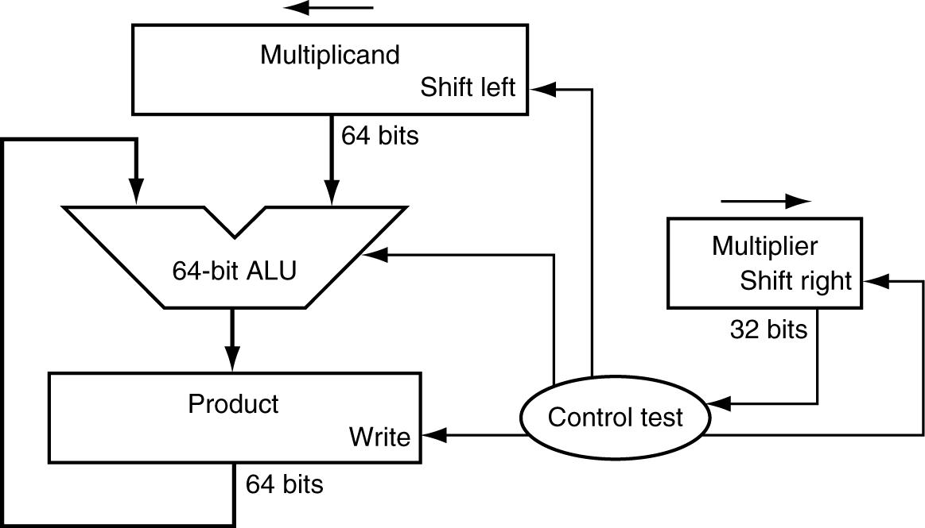
Multiplication Hardware
100000
1000
1000000
10000
0100
1001
0001
0010
00000000
01001000
00001000
Initially 0
184

Slide 11
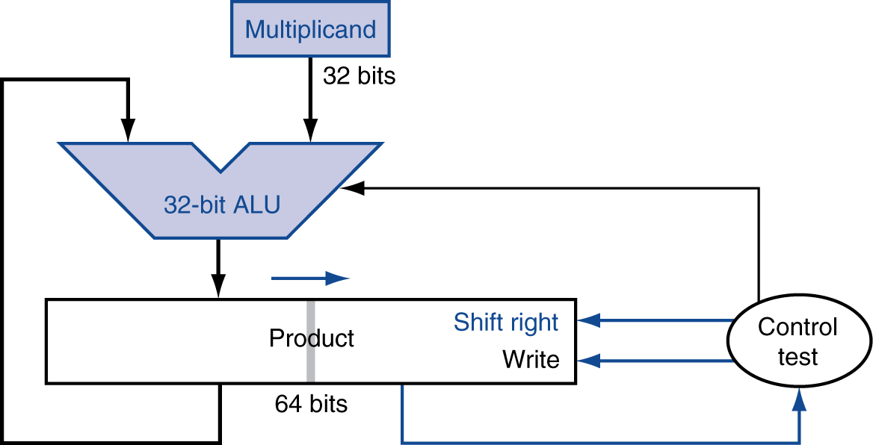
Optimized Multiplier
Perform steps in parallel: add/shift
1000
000001000
00001001000
00000001000
0000001000
00000000
0001
00001000
0010
1001
0100
One cycle per partial-product addition
That’s ok, if frequency of multiplications is low
186

Slide 12
Signed Multiplication
Remember original signs
Convert numbers to unsigned
Multiply
Change sign of result if indicated by signs of operands.
S = S1 XOR S2
187

Slide 13
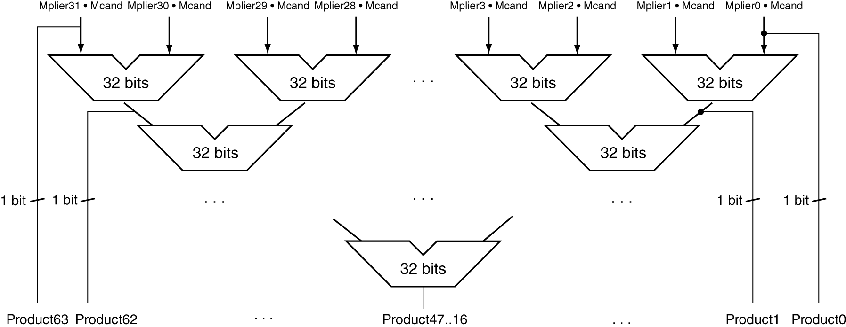
Faster Multiplier
Uses multiple adders
Cost/performance tradeoff
5 levels
Can be pipelined
Several multiplications performed in parallel
188

Slide 14
MIPS Multiplication
Two 32-bit registers for product
HI: most-significant 32 bits
LO: least-significant 32-bits
Instructions
mult rs, rt / multu rs, rt
64-bit product in HI/LO
mfhi rd / mflo rd
Move from HI/LO to rd
Can test HI value to see if product overflows 32 bits
mul rd, rs, rt
Least-significant 32 bits of product –> rd
Hi bits are lost
No destination
188

Slide 15
Division
§3.4 Division
Check for 0 divisor
Long division approach
If divisor ≤ dividend bits
1 bit in quotient, subtract
Otherwise
0 bit in quotient, bring down next dividend bit
Restoring division
Do the subtract, and if remainder goes < 0, add divisor back
Signed division
Divide using absolute values
Adjust sign of quotient and remainder as required
quotient
dividend
1001
1000 1001010
-1000
10
101
1010
-1000
10
divisor
remainder
n-bit operands yield n-bit quotient and remainder
189

Slide 16
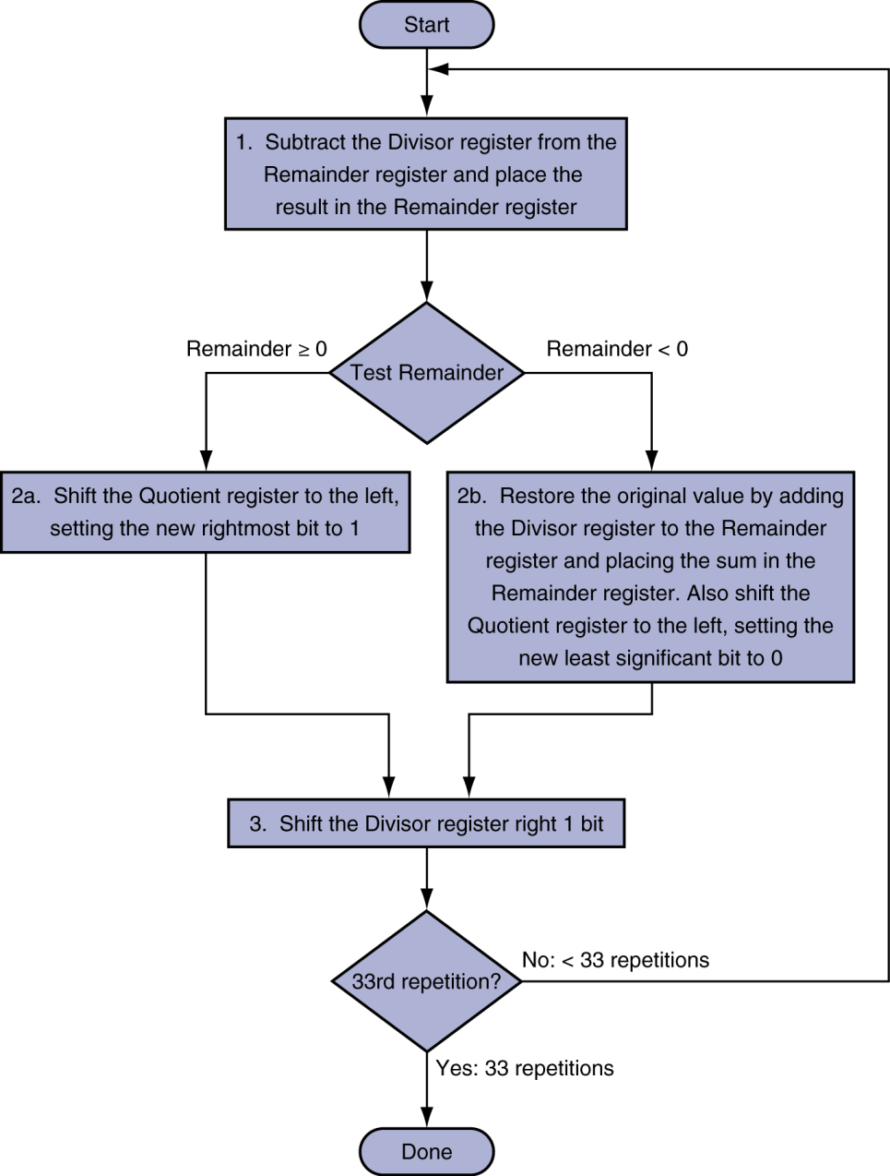
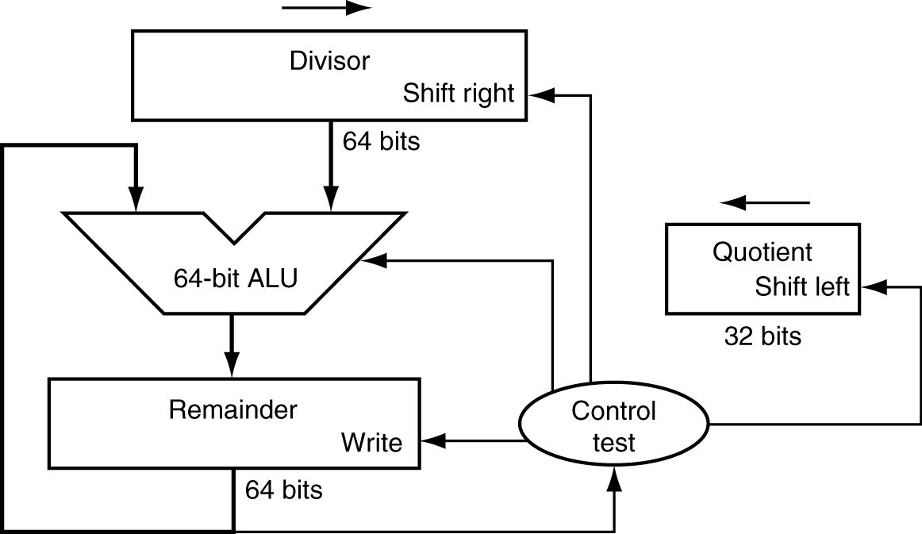
Division Hardware
Initially divisor in left half
Initially dividend
190

Slide 17
Division Example
7 / 2 = 3 r 1
0010 0000
0001 0000
0000 0001
0000 1000
0000 0010
0000 0100
+
-
0001
0011
0000
1111 1111
0000 0011
0000 0111
1111 0111
0000 0001
1110 0111
190

Slide 18
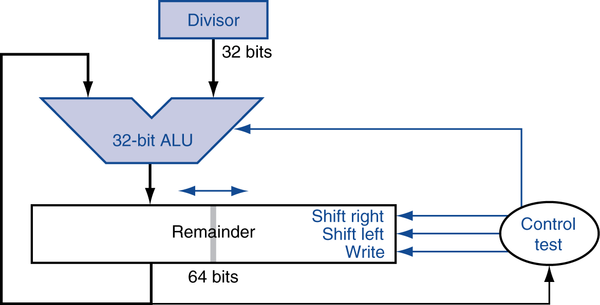
Optimized Divider
One cycle per partial-remainder subtraction
Looks a lot like a multiplier!
Same hardware can be used for both
192

Slide 19
Hardware Comparison
They look about the same

Slide 20
Signed Division
Like multiplication, the sign of the quotient is an XOR of the signs of the operands
The sign of the remainder is more difficult
Rule must always hold:
Dividend = Quotient * Divisor + Remainder
Remainder = Dividend – Quotient * Divisor
7 / -2 : -3 remainder 1
-7 / -2: 3 remainder -1
193

Slide 21
Faster Division
Can’t use parallel hardware as in multiplier
Subtraction is conditional on sign of remainder
Faster dividers (e.g. SRT division) generate multiple quotient bits per step
Still require multiple steps
Use lookup tables
Sweeney, Robertson, and Tocher
194

Slide 22
MIPS Division
Use HI/LO registers for result
HI: 32-bit remainder
LO: 32-bit quotient
Instructions
div rs, rt / divu rs, rt
No overflow or divide-by-0 checking
Software must perform checks if required
Use mfhi(r), mflo(q) to access result
194

Slide 23
Binary Fixed Point
Decimal fractions can be represented in binary
Sometimes not easily
Same rules apply as for decimal
Positive powers to the left of the point, negative powers to the right
So 1.5 in decimal is 1.1 in binary
1.125 in decimal is 1.001 in binary
5.625 is decimal is 101.101 in binary
0.1 in decimal is 0.000110011001100110011…

Slide 24
Floating Point
§3.5 Floating Point
Representation for non-integral numbers
Including very small and very large numbers
Like scientific notation
–2.34 × 10⁵⁶
+0.002 × 10^{–4}
+987.02 × 10⁹
In binary
±1.xxxxxxx₂ × 2^{yyyy}
Types float and double
normalized
not normalized
197

Slide 25
Floating Point Standard
Defined by IEEE Std 754-1985
Developed in response to divergence of representations
Portability issues for scientific code
Now almost universally adopted
Two common representations
Single precision (32-bit)
Double precision (64-bit)
Half-precision and quad-precision also available
198

Slide 26
IEEE Floating-Point Format
single: 8 bits double: 11 bits
single: 23 bits double: 52 bits
S
Exponent
Fraction
S: sign bit (0 ⇒ non-negative, 1 ⇒ negative)
Normalize significand: 1.0 ≤ |significand| < 2.0
Always has a leading pre-binary-point 1 bit, so no need to represent it explicitly (hidden bit)
Significand is Fraction with the “1.” restored
Exponent: excess representation: actual exponent + Bias
Ensures exponent is unsigned
Single: Bias = 127; Double: Bias = 1203
198

Slide 27
Representations
199

Slide 28
Single-Precision Range
Exponents 00000000 and 11111111 reserved
Smallest value
Exponent: 00000001 ⇒ actual exponent = 1 – 127 = –126
Fraction: 000…00 ⇒ significand = 1.0
±1.0 × 2^{–126} ≈ ±1.2 × 10^{–38}
Largest value
exponent: 11111110 ⇒ actual exponent = 254 – 127 = +127
Fraction: 111…11 ⇒ significand ≈ 2.0
±2.0 × 2⁺¹²⁷ ≈ ±3.4 × 10⁺³⁸
198

Slide 29
Double-Precision Range
Exponents 0000…00 and 1111…11 reserved
Smallest value
Exponent: 00000000001 ⇒ actual exponent = 1 – 1023 = –1022
Fraction: 000…00 ⇒ significand = 1.0
±1.0 × 2^{–1022} ≈ ±2.2 × 10^{–308}
Largest value
Exponent: 11111111110 ⇒ actual exponent = 2046 – 1023 = +1023
Fraction: 111…11 ⇒ significand ≈ 2.0
±2.0 × 2⁺¹⁰²³ ≈ ±1.8 × 10⁺³⁰⁸
298

Slide 30
Floating-Point Precision
Relative precision
all fraction bits are significant
Single: approx 2^{–23}
Equivalent to 23 × log₁₀2 ≈ 23 × 0.3 ≈ 6 decimal digits of precision
Double: approx 2^{–52}
Equivalent to 52 × log₁₀2 ≈ 52 × 0.3 ≈ 16 decimal digits of precision
201

Slide 31
Floating-Point Example
Represent –0.75
–0.75 = (–1)¹ × 1.1₂ × 2^{–1}
S = 1
Fraction = 1000…00₂
Exponent = –1 + Bias
Single: –1 + 127 = 126 = 01111110₂
Double: –1 + 1023 = 1022 = 01111111110₂
Single: 1011111101000…00
Double: 1011111111101000…00
201

Slide 32
Floating-Point Example
What number is represented by the single-precision float 0xC0A00000
11000000101000…00
S = 1
Fraction = 01000…00₂
Exponent = 10000001₂ = 129
x = (–1)¹ × (1 + 01₂) × 2^{(129 – 127)}
= (–1) × 1.25 × 2²
= –5.0
202

Slide 33
Denormal Numbers
Exponent = 000...0 ⇒ hidden bit is 0
Smaller than normal numbers
allow for gradual underflow, with diminishing precision
Denormal with fraction = 000...0
Two representations of 0.0!

Slide 34
Infinities and NaNs
Exponent = 111...1, Fraction = 000...0
±Infinity
Can be used in subsequent calculations, avoiding need for overflow check
Exponent = 111...1, Fraction ≠ 000...0
Not-a-Number (NaN)
Indicates illegal or undefined result
e.g., 0.0 / 0.0
Can be used in subsequent calculations

Slide 35
Floating-Point Addition
Consider a 4-digit decimal example
9.999 × 10¹ + 1.610 × 10^{–1}
1. Align decimal points
Shift number with smaller exponent
9.999 × 10¹ + 0.016 × 10¹
2. Add significands
9.999 × 10¹ + 0.016 × 10¹ = 10.015 × 10¹
3. Normalize result & check for over/underflow
1.0015 × 10²
4. Round and renormalize if necessary
1.002 × 10²
203

Slide 36
Floating-Point Addition
Now consider a 4-digit binary example
1.000₂ × 2^{–1} + –1.110₂ × 2^{–2} (0.5 + –0.4375)
1. Align binary points
Shift number with smaller exponent
1.000₂ × 2^{–1} + –0.111₂ × 2^{–1}
2. Add significands
1.000₂ × 2^{–1} + –0.111₂ × 2–1 = 0.001₂ × 2^{–1}
3. Normalize result & check for over/underflow
1.000₂ × 2^{–4}, with no over/underflow
4. Round and renormalize if necessary
1.000₂ × 2^{–4} (no change) = 0.0625
203

Slide 37
FP Adder Hardware
Much more complex than integer adder
Doing it in one clock cycle would take too long
Much longer than integer operations
Slower clock would penalize all instructions
FP adder usually takes several cycles
Can be pipelined

Slide 38
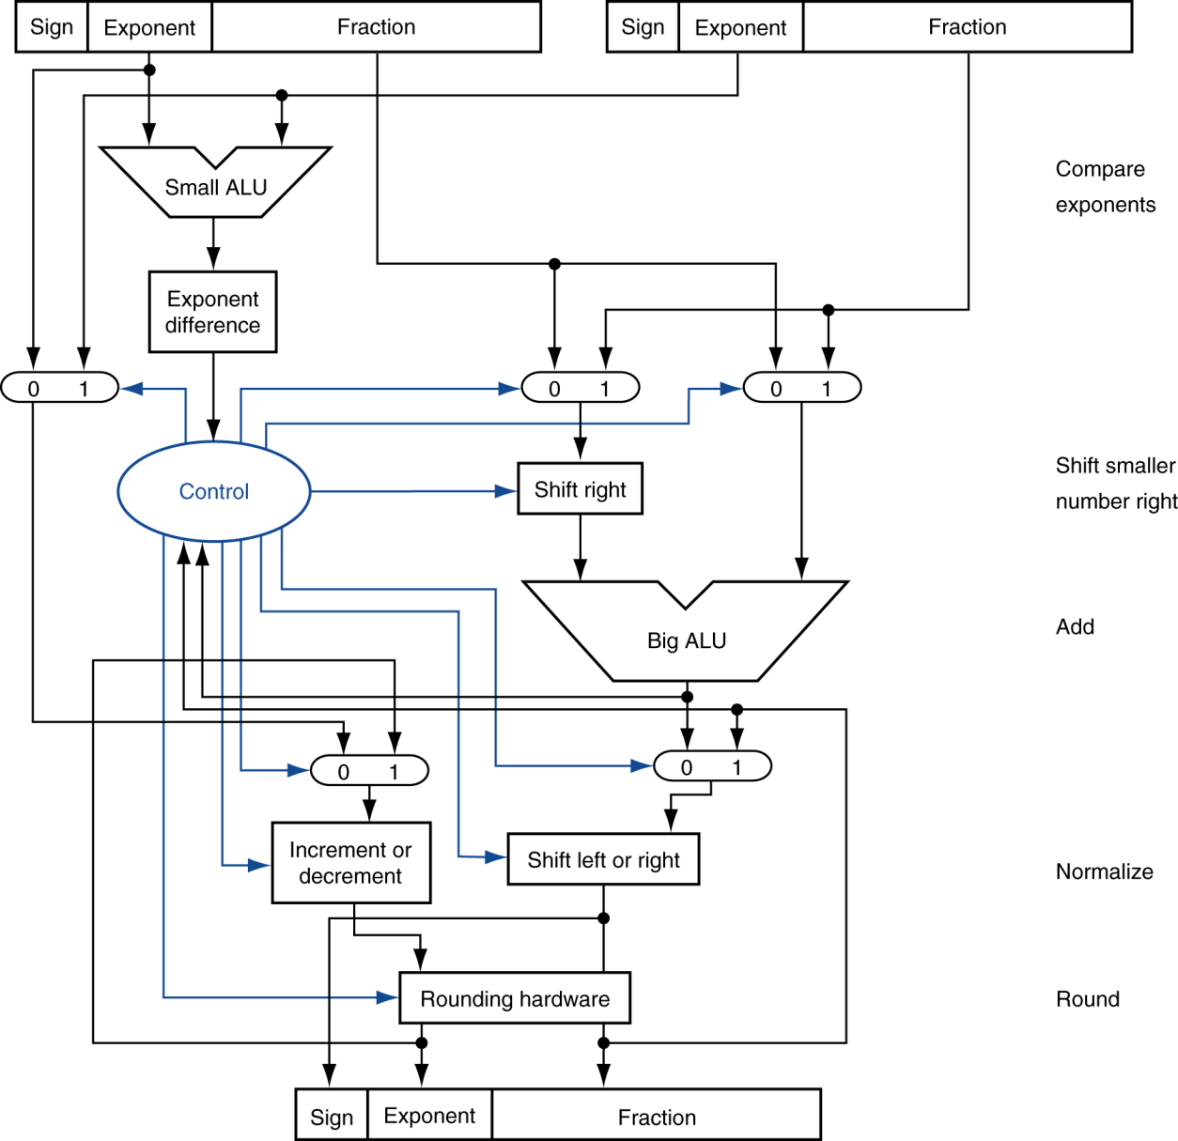
FP Adder Hardware
Step 1
Step 2
Step 3
Step 4

Slide 39
Floating-Point Multiplication
Consider a 4-digit decimal example
1.110 × 10¹⁰ × 9.200 × 10^{–5}
1. Add exponents
For biased exponents, subtract bias from sum
New exponent = 10 + –5 = 5
2. Multiply significands
1.110 × 9.200 = 10.212 ⇒ 10.212 × 10⁵
3. Normalize result & check for over/underflow
1.0212 × 10⁶
4. Round and renormalize if necessary
1.021 × 10⁶
5. Determine sign of result from signs of operands
+1.021 × 10⁶
206

Slide 40
Floating-Point Multiplication
Now consider a 4-digit binary example
1.000₂ × 2^{–1} × –1.110₂ × 2^{–2} (0.5 × –0.4375)
1. Add exponents
Unbiased: –1 + –2 = –3
Biased: (–1 + 127) + (–2 + 127) = –3 + 254 – 127 = –3 + 127
2. Multiply significands
1.000₂ × 1.110₂ = 1.110₂ ⇒ 1.110₂ × 2^{–3}
3. Normalize result & check for over/underflow
1.110₂ × 2^{–3} (no change) with no over/underflow
4. Round and renormalize if necessary
1.110₂ × 2^{–3} (no change)
5. Determine sign: +ve × –ve ⇒ –ve
–1.110₂ × 2^{–3} = –0.21875
206

Slide 41
FP Arithmetic Hardware
FP multiplier is of similar complexity to FP adder
But uses a multiplier for significands instead of an adder
FP arithmetic hardware usually does
Addition, subtraction, multiplication, division, reciprocal, square-root
FP ↔ integer conversion
Operations usually takes several cycles
Can be pipelined
211

Slide 42
FP Instructions in MIPS
FP hardware is coprocessor 1
Adjunct processor that extends the ISA
Separate FP registers
32 single-precision: $f0, $f1, … $f31
Paired for double-precision: $f0/$f1, $f2/$f3, …
Release 2 of MIPs ISA supports 32 × 64-bit FP reg’s
FP instructions operate only on FP registers
Programs generally don’t do integer ops on FP data, or vice versa
More registers with minimal code-size impact
FP load and store instructions
lwc1, ldc1, swc1, sdc1
e.g., ldc1 $f8, 32($sp)
211

Slide 43
FP Instructions in MIPS
Single-precision arithmetic
add.s, sub.s, mul.s, div.s
e.g., add.s $f0, $f1, $f6
Double-precision arithmetic
add.d, sub.d, mul.d, div.d
e.g., mul.d $f4, $f4, $f6
Single- and double-precision comparison
c.xx.s, c.xx.d (xx is eq, lt, le, …)
Sets or clears FP condition-code bit
e.g. c.lt.s $f3, $f4
Branch on FP condition code true or false
bc1t, bc1f
e.g., bc1t TargetLabel
211

Slide 44
FP Example: °F to °C
C code:
float f2c (float fahr) { return ((5.0/9.0)*(fahr - 32.0)); }
fahr in $f12, result in $f0, literals in global memory space
Compiled MIPS code:
f2c: lwc1 $f16, const5($gp) lwc2 $f18, const9($gp) div.s $f16, $f16, $f18 lwc1 $f18, const32($gp) sub.s $f18, $f12, $f18 mul.s $f0, $f16, $f18 jr $ra
214

Slide 45
FP Example: Array Multiplication
X = X + Y × Z
All 32 × 32 matrices, 64-bit double-precision elements
C code:
void mm (double x[][], double y[][], double z[][]) { int i, j, k; for (i = 0; i< 32; i++) for (j = 0; j < 32; j++) for (k = 0; k < 32; k++) x[i][j] = x[i][j] + y[i][k] * z[k][j]; }
Addresses of x, y, z in $a0, $a1, $a2, and i, j, k in $s0, $s1, $s2
215

Slide 46
Illustrated
X
X
Y
Z
=
+
x

Slide 47
FP Example: Array Multiplication
MIPS code:
li $t1, 32 # $t1 = 32 (row size/loop end) li $s0, 0 # i = 0; initialize 1st for loop L1: li $s1, 0 # j = 0; restart 2nd for loop L2: li $s2, 0 # k = 0; restart 3rd for loop sll $t2, $s0, 5 # $t2 = i * 32 (size of row of x) addu $t2, $t2, $s1 # $t2 = i * size(row) + j sll $t2, $t2, 3 # $t2 = byte offset of [i][j] addu $t2, $a0, $t2 # $t2 = byte address of x[i][j] l.d $f4, 0($t2) # $f4 = 8 bytes of x[i][j] L3: sll $t0, $s2, 5 # $t0 = k * 32 (size of row of z) addu $t0, $t0, $s1 # $t0 = k * size(row) + j sll $t0, $t0, 3 # $t0 = byte offset of [k][j] addu $t0, $a2, $t0 # $t0 = byte address of z[k][j] l.d $f16, 0($t0) # $f16 = 8 bytes of z[k][j] …
216

Slide 48
FP Example: Array Multiplication
… sll $t0, $s0, 5 # $t0 = i*32 (size of row of y) addu $t0, $t0, $s2 # $t0 = i*size(row) + k sll $t0, $t0, 3 # $t0 = byte offset of [i][k] addu $t0, $a1, $t0 # $t0 = byte address of y[i][k] l.d $f18, 0($t0) # $f18 = 8 bytes of y[i][k] mul.d $f16, $f18, $f16 # $f16 = y[i][k] * z[k][j] add.d $f4, $f4, $f16 # f4=x[i][j] + y[i][k]*z[k][j] addiu $s2, $s2, 1 # $k k + 1 bne $s2, $t1, L3 # if (k != 32) go to L3 s.d $f4, 0($t2) # x[i][j] = $f4 addiu $s1, $s1, 1 # $j = j + 1 bne $s1, $t1, L2 # if (j != 32) go to L2 addiu $s0, $s0, 1 # $i = i + 1 bne $s0, $t1, L1 # if (i != 32) go to L1
217

Slide 49
Associativity
Parallel programs may interleave operations in unexpected orders
Assumptions of associativity may fail
§3.6 Parallelism and Computer Arithmetic: Associativity
Need to validate parallel programs under varying degrees of parallelism

Slide 50
Interpretation of Data
The BIG Picture
Bits have no inherent meaning
Interpretation depends on the instructions applied
Computer representations of numbers
Finite range and precision
Need to account for this in programs

Slide 51
Floating Point Conversion
Decimal to Binary
Convert -13.375 to single-precision binary floating point (express in hex)
Sign bit is 1
Number in binary is 1101.011
Number in scientific notation is 1.101011 x 2³
Fraction (omitting initial 1) is 101011
Exponent is 3 + 127 = 130 = 10000010
S-E-F is 1- 10000010-101011 000…
Group by 4’s
1100 0001 0101 0110 00…
0xC1560000

Slide 52
Floating Point Conversion
Hexadecimal IEEE-754 to decimal
Example: 0x40480000
Write in binary: 0100 0000 0100 1000 0000…
Group into S-E-F: 0 10000000 10010000000…
S = 0 (number is positive)
E is 128, so power of 2 is 128-127 = 1
Reconstitute F: 1.1001
Write in scientific notation: 1.1001 x 2¹
11.001
= 3.125

Slide 53
Who Cares About FP Accuracy?
Important for scientific code
But for everyday consumer use?
“My bank balance is out by 0.0002¢!” ☹
The Intel Pentium FDIV bug
The market expects accuracy
See Colwell, The Pentium Chronicles

Slide 54


Slide 55
Chronology
July 1994: Intel discovers the bug in the Pentium. The actual cost to fix the bug was several hundred thousand dollars.
September 1994: A math professor at Lynchburg College in Virginia, Thomas Nicely, discovers the bug, After calling Intel technical support and getting no official reaction, he posts his discovery on the Internet.

Slide 56
Chronology 2
November 22, 1994: Intel issues a press release, calling it a "glitch." The Pentium "can make errors in the ninth digit. ... Even most engineers and financial analysts require accuracy only to the fourth or fifth decimal point.
December 5,1994: Intel claims the flaw happens once in 27,000 years
December 12,1994: IBM Research Division days once every 24 days

Slide 57
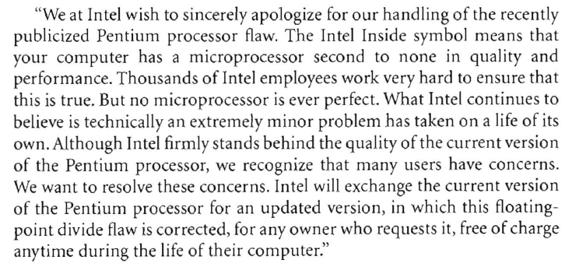

Chronology 3
December 21, 1994: Intel releases the following, signed by Intel's president:
Analysts estimate that this recall cost Intel $500 million, and Intel engineers did not get a Christmas bonus that year.

Slide 58
Subword Parallelism
Remember parallelism means there’s a pattern to something
In this case, it’s the same operation done on different data
Subword refers to divisions in data smaller than a word (or register)
Involves use of carry partitions in registers
Blocks the cascading of a carry to the next digit to the left.
Adds use the same circuitry, but can be done in parallel
128-bit register can handle 2 64-bit words, 4 32-bit values, 8 16-bit values, etc.
222

Slide 59
Subword Parallelism is also
Data-level parallelism
Single instruction multiple data (Flynn’s taxonomy)
222

Slide 60
The ARM implementation
Called NEON
About 100 instructions
223

Slide 61
The Intel Implementation
Multimedia extensions (MMX)
Streaming SIMD extension (SSE and SSE2)
Added 144 instructions
Eight 64-bit fp registers
AMD doubled the registers and called it XMM
Intel did the same thing and called it EM64T
Intel added 128-bit registers
Can operate on 4 single-precision or 2 double-precision numbers

Slide 62
Advanced Vector Extensions (AVX)
Intel, 2011
256-bit registers
Arithmetic instructions can now be three registers (instead of two)
Need new load/store instructions
Can read aligned or unaligned

Slide 63
DGEMM
Double Precision, General Matrix Multiply.`
void dgemm (int n, double* A, double* B, double* C)
{
for (int i 0; i < n; ++i )
for (int j = 0; j < n; ++j)
{
double cij C[i+j*n];
for( int k = 0; k < n; k++ )
cij += A[i+k*n] * B[k+j*n];
C[i+j*n] = cij;
}
}
Unoptimized code

Slide 64
Doing four things at a Time
=
x

Slide 65
Optimized code
#include <x86intrin.h>
void dgemm (int n. double* A, double* B, double* C)
{
for ( int i 0 ; i < n ; i +=4 )
for ( int j = 0; j < n; j++ )
{
_m256d cO = _mm256_load_pd(C+i+j*n);
for( int k = 0; k < n; k++ )
cO = _mm 256_add_pd (c0,
_mm 256_mul _pd (_mm 256_l oad_pd(A+i+k*n),
_mm 256_broadcast_sd(B+k+j*n )));
_mm 256_store_pd(C+i+j*n . cO);
}
}

Slide 66
Comments about shortcuts
Shifting left and right are shortcuts for multiply and divide
Unsigned only
No overflow
Associativity of floating point ops in parallel

Slide 67
MIPS Core Instructions
Those executed on the hardware
Not pseudo instructions
Whole set of real and pseudo instructions called MIPS 32
Core instructions cover most needs

Slide 68
Floating Point Exercises
-12.5 0xc1480000
15.875 0x417e0000
33.75 0x42070000
-0.0625 0xbd800000

